Slide 1
Mega E-commerce Project

Slide 2
Who we are??
Nouran Mohammed Ebrahim Apo-Elkhier
Ghada Magdi Ahmed El-khalifa
Habiba Taha Abdelrazik Mohamed
Mennat-Allah Hisham Aly Ahmed
Youssef Osama Farouk Kamel
Ziad taha

Slide 3

Thinking in our life??

Slide 4

Then we get the idea
The idea came from the need to simplify the online shopping experience.
Users want to find all products in one place easily and quickly.
Combining a smooth user experience with a full-featured platform.

Slide 5

The problem that face us?
Online shopping websites are scattered, making it hard to find multiple products.
Tracking orders after purchase is often difficult.
Some websites are not user-friendly on mobile or desktop.

Slide 6

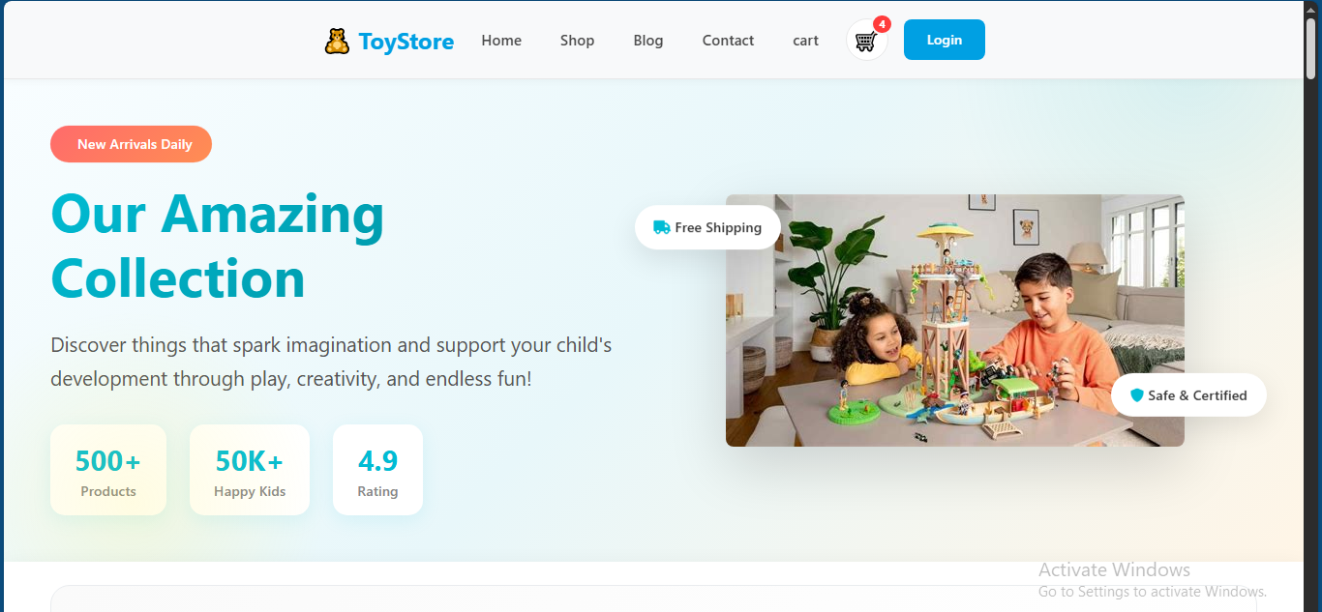
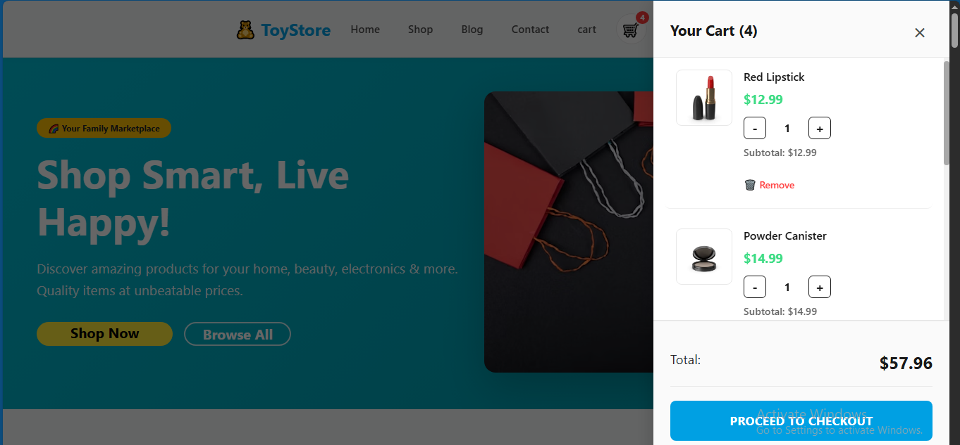
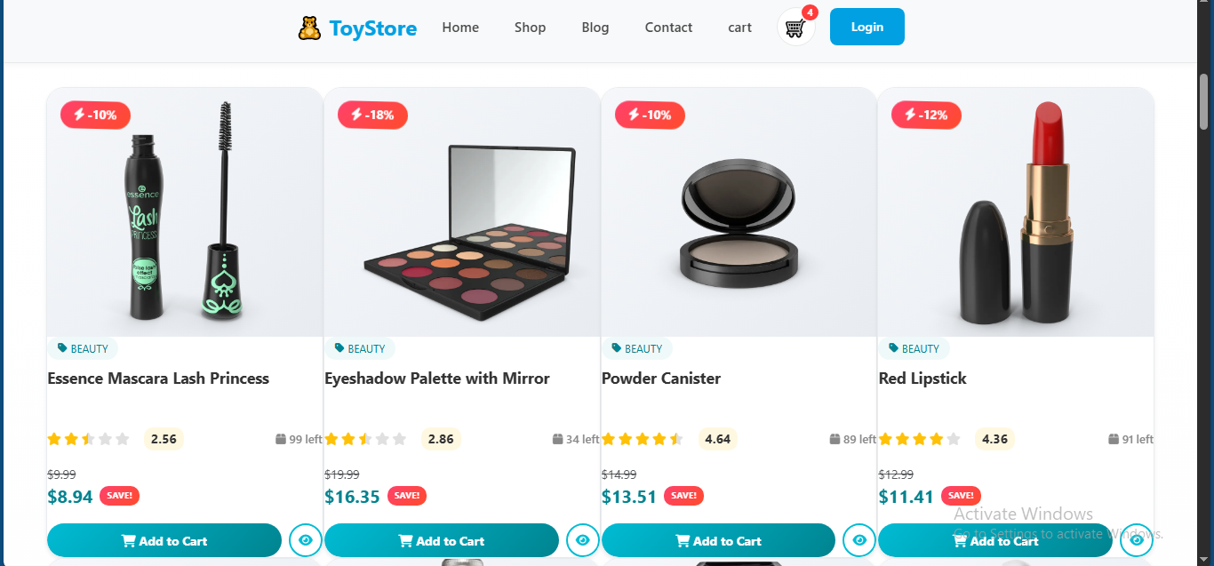
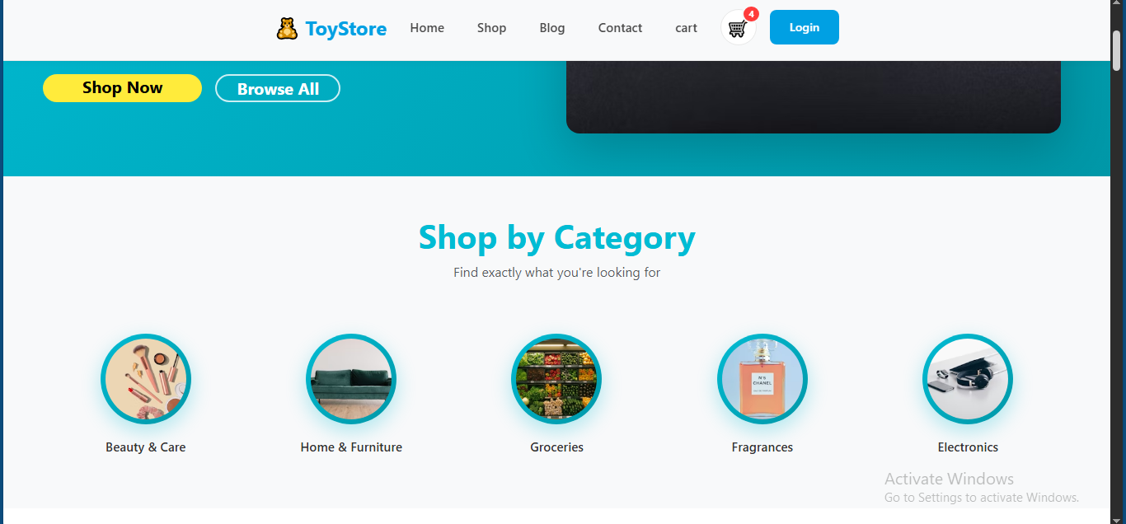
The solution of the problem

Slide 7
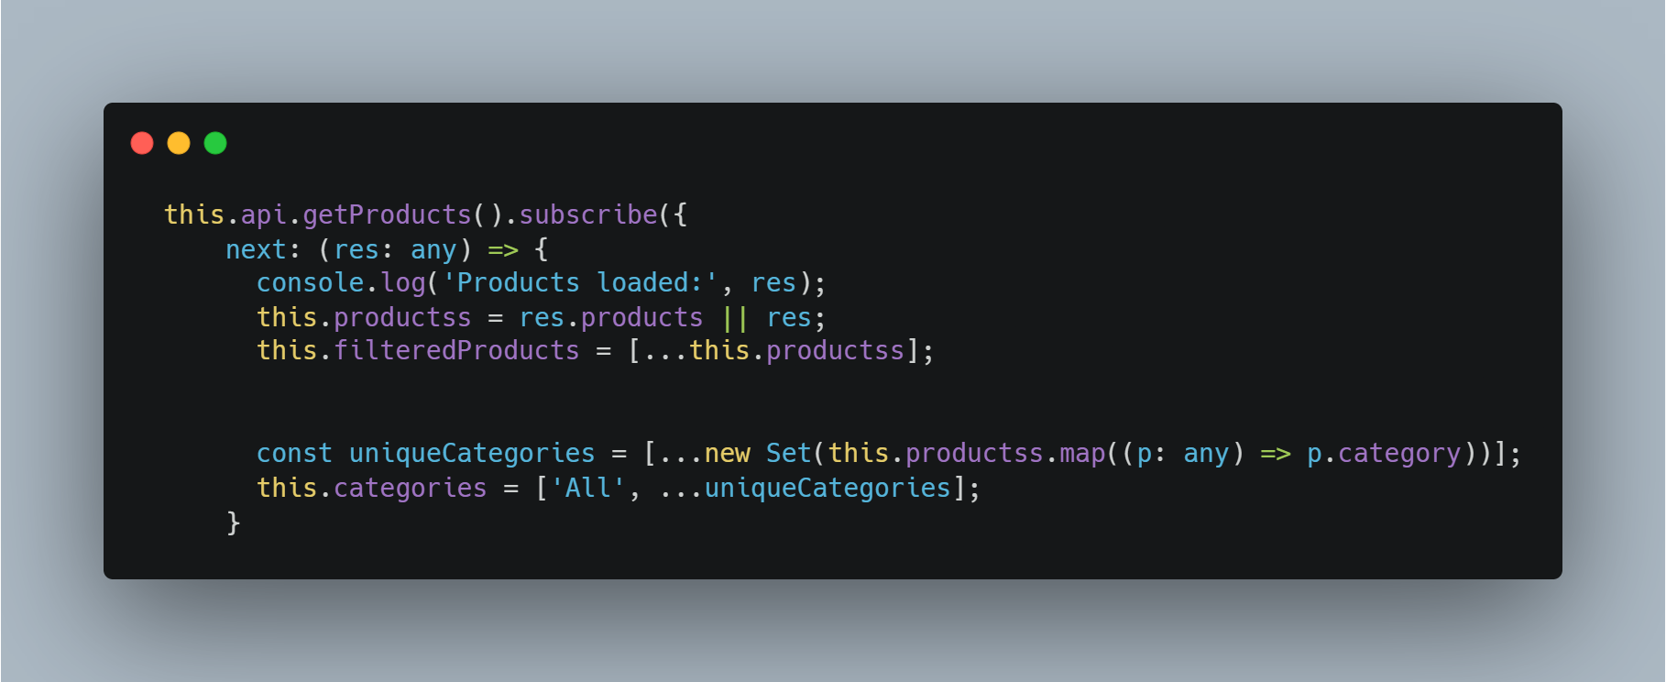

Slide 8
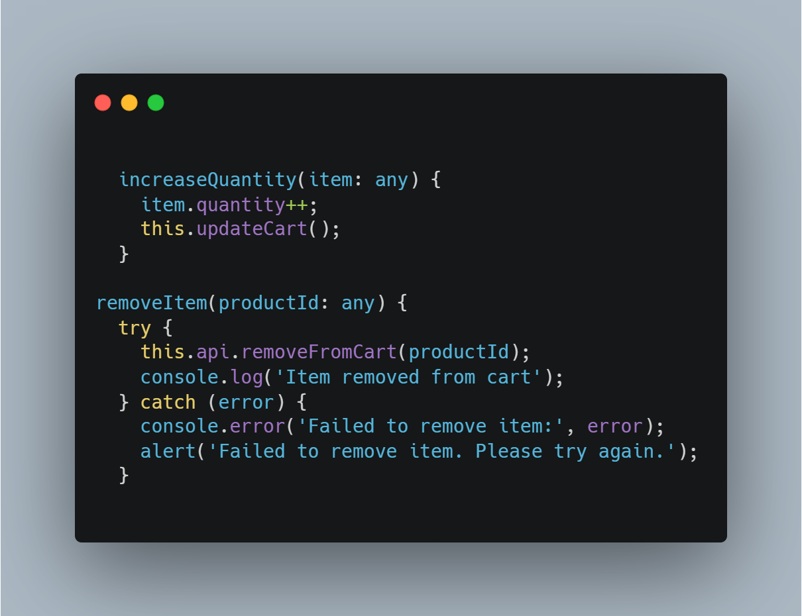
Here you can see the logic behind our interactive cart. We ensure that when a user adjusts quantities or removes an item, the cart updates instantly while safely handling any potential errors in the background.

Slide 9
The solution of the problem
Developed a full E-commerce platform:
  Organized and easy product display.
  Shopping cart for convenient purchasing.
  User login and order tracking.
  Secure and simple checkout page.
  Responsive design for all devices.

Slide 10
conclusion
The Mega E-commerce Project provides a complete solution for online shopping , Can be developed further with more features in the future ,Thank you for listening .

Slide 11
THANK YOU

